Slide 1
Geometry
Galan
LAHSA - 2023-2024

Slide 2
Mr. Galan
Room: 452
Email: egalan@lausd.net
Telephone: 323-457-0924
Bio: Mr. Galan has been teaching Math and Computer science for 32 years. He is a founding teacher of Los Angeles High School of the Arts. He is an active member of Math For America Los Angeles (MFALA.org). On his free time, he sponsonsors LAHSA’s Music Factory music club, and collaborates with the Theater Department as a Music Director. Mr. Galan loves his cats and dogs.

Slide 3
What is Geometry
Geometry is the branch of Mathematics that deals with the properties and relations of points, lines, surfaces, solids, and higher dimensional analogs.
In short, Geometry is the study of shapes.

Slide 4
Geometry: Course Objectives/Learning Targets
The course objectives or learning targets for Geometry are:
Constructions | Rigid Transformations | Congruence | Similar Figures
Triangles | Right Triangle Trigonometry | Circles | Coordinate Geometry

Slide 5
Grading Rubric
Advanced 4 | I demonstrate mastery of the LT. I can apply complex concepts to a variety of problem types.
Proficient 3 | I demonstrate proficiency of the LT, and can do complex problems with minor errors.
Developing 2 | I demonstrate basic grade-level understanding of the LT, but not a full conceptual understanding.
Emerging 1 | I demonstrate approaching grade-level understanding of the LT, but still need to work on the mathematical concepts and procedures
Not Yet 0 | I demonstrate below grade-level understanding of the LT. I cannot do these types of problems yet.

Slide 6
Grading Categories
Grades in this class will be composed of the following categories.
Assessments: Quizzez/Tests, Projects, Final Exam 90%
Participation 10%

Slide 7
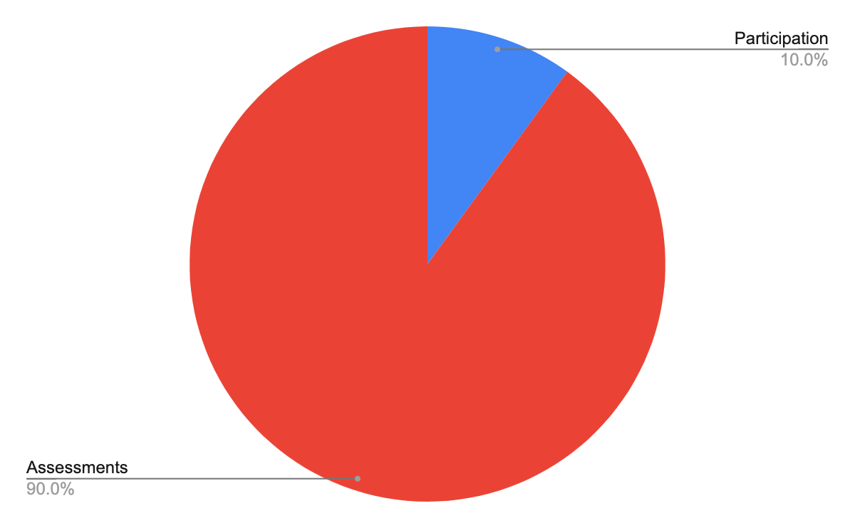
Grade Distribution
The pie chart at the right shows the grade distribution for the two major categories of Assessments and Participation.
Notice that Participation only helps 10% of your overall grade, while Assessments cover 90% of your grade. In other words you cannot pass the class with Participation alone

Slide 8
Cell Phone Policy
My Cell Phone Policy is the following:
We will NOT be using the cell phone in class. You are to put your cell phones away at the beginning of class. If I see you using your phone I will ask you for it.
1st: You get your phone back at end of class.
2nd: You get your phone back at end of school day.
3rd: You must get your phone back from the office.
In any case, I will be calling home and making a note on your permanent MISIS record.

Slide 9
Note to Parents About Cell Phones
Dear parents, If you should have to get a hold of your son or daughter during school hours, kindly call the school office (213) 480-4600. They will call my room and your child can come to the office to talk to you.

Slide 10
Bathroom Policy
You may go to the bathroom if you have YOUR OWN STUDENT AGENDA. Each time you leave the room for bathroom or water, you will owe me 5 minutes during the upcoming break - Nutrition, Lunch, or After School.

Slide 11
Tardy Policy
Each time you arrive late to class you will owe me 5 minutes during the upcoming break - Nutrition, Lunch, After School.
Please plan ahead and do your best to Be ON TIME.
Late constitutes any time after the scheduled start of class. Please make sure you know the schedule.

Slide 12
Parent Verification
Please click on the link below, complete, and submit the verification that you and your parents have read and understand my expectations of you in my class.
Click Here for Verification

